Slide 1
Quarterly Macro-Fiscal Outlook
Summary Forecast 2023-26
June 2, 2023 (rev. structure Aug.2023)

Slide 2
I. Rationale of outlook & underlying model
Provide forecast for 16 quarters ahead for key macro variables (i.e,. output, inflation, final demand…...) as influenced by fiscal, monetary, and exchange rate policies, incl. in response to shocks and new developments
Simulate alternative policy scenarios suggest policy implications & recommendations.
Provide input to (Qo or Ann. assumptions), and complement, other tools projections
validate macro-fiscal projections that underpin the (medium-term) Budgets and IMF-supported programs
facilitate coordination of policies between MINECOFIN
Tool/model: Quarterly Macro Fiscal Model (QMFM), a so-called “gap” model:
special emphasis on fiscal deficit indicators & components (revenue, Govt spending & structural, discretional, cyclical)
tracing key macro variables in deviation from trends, potential levels, or targets
after shocks and policy responses, variables return to their LT trends subject to persistence/lags & s.states.
trends converge to steady states (outside model), e.g., potential output growth, interest and exchange rates neutral rate & target, sustainable deficit level and target inflation….

Slide 3
Model/Qo outlook rationale & requests + recommendations
The quarterly Outlook—produced along with results of macro framework and NBR forecasting tools
—should help in framing macro economic assumptions for InMF and other tools
—should help generate the validated macro-fiscal projections that underpin the (medium-term) Budgets and IMF-supported programs and facilitate coordination of policies between MINECOFIN and NBR.
—in the process of reconciling the results from various tools, iterative policy scenarios are run, and recommendations formulated outside the Outlook.
—MINECOFIN’s independent assessment of the macro-outlook and the effects and interactions of fiscal with other policies—which may differ from those in other tools
—should further enhance the macroeconomic analysis and policy debate
Data plea
NBR-FPAS inflation & ER outlook
Fiscal (Qo treasury plan for 2023/24 is not available) and Debt stock actual or provisional data
Notes:
MINECOFIN can have a different assessment of path and impact of monetary and ER policies than NBR, just as NBR can have a different assessment of path and impact of fiscal policies.

Slide 4
1I. Recent macroeconomic developments (2017-23) new Fiscal policy indictors
Fiscal deficit (%GDP) and Govt demand (level & %GDP)
fiscal consolidation—with a decreasing deficit of 10% average for 2015/16—2018/19, mainly driven by Govt demand discretion spending (i.e., use of goods and services..)
expansionary fiscal—with increased deficit for FY 2019/20—2021/22 of 14.1% average triggered by Covid-spending & discr. Govt spending incl. NINFA, (i.e.,. mass School constructions) and use goods and services, mostly related to foreign finance portion.
revived fiscal consolidation—with deficit declining of 12%—10.8% for FY 2022/23—2023/24, driven by a reduction in capital spending, and net lending (equities and shares (Euro bond investment projects), and loans(B/s support funds)).
Govt demand deflated in real terms by a surging inflation from 2022, but inflated again by floods response for last quarter of FY 2022/23.

Slide 5
Recent macroeconomic developments cnt’ Real GDP/Output
Output gap drivers
Covid years (2020-21)
consumption and investment accounted for most of the GDP drop and output gap
fall in imports and expansionary government demand helped mitigate the downpull on GDP
Immediate post-Covid (2021-22)
consumption and investment contributed most to the recovery
supported by continued government demand, while exports remained sluggish
Ukraine-war (2022-23)
post-Covid recovery slowed down due to jumps in international oil and food prices, causing high inflation and drop in real consumption and other demand
fiscal consolidation started (though in part thwarted by floods) and lowered the expansionary effect of govt demand
Real GDP, (YoY %)
averaged to 7.5% during 2000-19 and estimated a bit below potential in 2019;
Contracted/dropped by 3.4% and was 12% below potential level had normal growth (potential) of 7.5% continued during COVID-2020 due to supply constraints and drops in external and domestic demand.
expansionary fiscal policy helped in subsequent recovery of economy, despite strong bounce back in 2021 economy is estimated below potential.
Global instability such Ukraine War affected domestic economy slowed down the recovery from 2022Q1 onward.

Slide 6
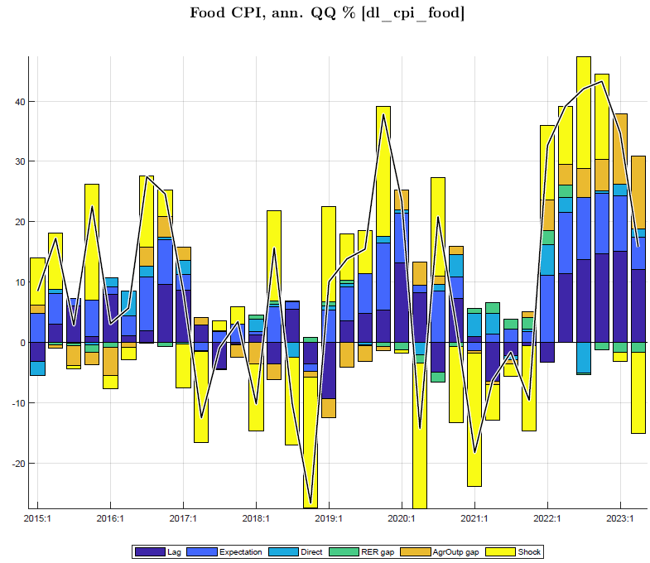
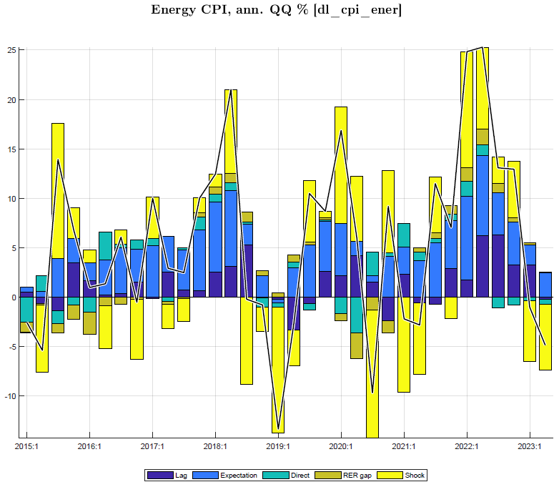
Recent macroeconomic developments cnt’ Inflation—CPI
Headline—CPI drivers
Covid years (2020-21) & before
above target driven by food prices in 2017
lower driven a fall in food prices for 2018-19
above target during in 2020 induced by higher COVID-related food and core prices (imports)?
Immediate post-Covid (2021-22)
lower driven by recovery in terms of good agric harvest and less expensive imports
Ukraine-war (2022-23)
higher core prices (driven by Ukraine-war induced shocks than standard factors i.e., output gap)—weak output gap relation to P.C relation–weak monetary policy to output to inflation?
higher food prices: negatively driven by agricultural production gap and agric-related shocks
higher international energy and commodity prices
CPI, (YoY %)
highly volatile, mostly driven by factors (i.e., agric & weather shocks) unrelated to business cycle (i.e., not consistent with a still -ve output gap)
main factors incl. weather-induced fluctuations in harvests and agricultural prices, openness and dependence on imports, especially for food and petroleum products with volatile international prices, and lack of competition in many markets
food and energy are main drivers of this volatility inflation directly and indirectly.
recent surge in inflation was more driven by weak harvests coincided with soaring of world food and energy prices.
deceleration observed through a drop in components since 2023Q1.

Slide 7
2. Summary recent/current policy stance new
Initial condition: recent past developments/trends (2017-2022)
accelerated domestic inflation, (from lower levels ex-ante 2021), ER depreciation (overvaluation) amidst domestic shocks & unfavourable global environment
tight domestic & global monetary policies post COVID (RIR and foreign interest rates loose before 2020)
expansionary fiscal policy counter shocks
GDP below 7.5% trend (2000-19), just above trend (2019) due to Govt demand and substantially contracted to negative during COVID
Current & near-term policy stance (2023-24)
improving and favourable global environment in terms of recovering foreign demand, easing world food and oil prices & trading partner's CPI.
modestly tight monetary policy amidst decelerating domestic inflation
fiscal consolidation in 2022/23 reinforced with the FY2023/24 Budget,
exchange rate policy entailing initially some overvaluation have helped contain domestic demand and bring inflation down in 2023, and should continue doing so in the near future.
inflation (shocks) abates, room for procyclical policies to demand/GDP growth back to its potential level, stabilize the fiscal deficit at its sustainable level, and stabilize the RER.

Slide 8
3. Forecast assumptions (tunes) 2023Q3-2024Q1 slightly revised
The forecasts are conditional on exogenous and judgmental assumptions:
external environment (foreign prices, demand, food/oil prices, interest rates, )
domestic trends and gaps distilled from historic data (quarterly 2006-23)
domestic near-term forecasts (now/forecast GDP, latest CPI, judgements…)
recently observed shocks disappear, e.g., agriculture normalizes and food and core price shocks are abating.
Forecast conditional on exogenous judgment assumptions incl.
WEO forecasts for external variables (e.g., foreign prices, demand,..);
domestic trends (e.g., GDP, real interest rates,..) as derived from data and judgment;
near-term now/forecasts or estimates from other tools, sources or judgment (GDP, CPI, shocks);
known/observed or expected fiscal policies (deficit, revenue, spending) for two fiscal years and monetary and exchange rate policies for current and possibly next quarter.
Notes:
The QMFM model is originated or derived from a canonical-new Keynesian reduced form model (log-linearized equations of a micro-founded model)

Slide 9
3.1 External environment/outlook
overall outlook is improving after the Covid-Ukraine crises, but with downside risks. World economy is slowing down due to world increased interest rate in response to inflation
World economy slowing down as interest rates are raised in response to inflation
Rwanda still enjoys recovery in trading partner demand relative to Covid-years, at 3% p.y., well above trend
World real interest rates are expected to rise from negative around -1% in the past decade to +1% by 2027, with the increase likely transmitting one-for-one to Rwanda’s sovereign borrowing rates
Trading partners’ CPI inflation (in US$)—subdued at 1.5% p.y. in the past 5-7 years—is projected to return to its trend level of 2% in the coming years

Slide 10
3.2 Domestic environment assumptions
Current fiscal, monetary, and exchange rate policies (in part “tuned”):
post-Covid consolidation and winding down of crisis-related spending since 2021/22 reinforced in 2023/24 Budget,
a further reduction in the deficit before grants to 10.8% of GDP in 2023/24, and to 9.7 % by 2025/26
fiscal deficit (excl. grants) assumed return to 8% level for beyond PCI program (2025/26-2026/27)
maintenance of current level of policy interest rate (interbank rate) for 2023Q4 (8%)
somewhat faster exchange rate depreciation in 2023 (than 2022), based on statements and the IMF PCI program targets (i.e., Q4 is NBR = IMF program forecast --15% eopER depr in 2023, quarterlized and applied to Q3 p.a.)
expected return to normal of agricultural harvests and domestic food prices and rep. shocks during 2023Q4-24Q1
The 2023/24 and 2024/25 Budget deficits and spending on G&S have been tuned based on the semester breakdown of annual figures (because the projected quarterly breakdown is not available), hence quarters are the same within the semester
Notes:
The QMFM sustainable debt-creating deficit is 5% of GDP under assumptions of: debt/GDP target of 55% (45% in NPV terms, o/w 10% domestic and 35% foreign debt, grant element 22%), real GDP growth 7.5% p.y., trading partner inflation 2% p.y., and trend RER depreciation rate 0%. The structural deficit consists of revenue 21%, government consumption 13%,government investment 11%, and other spending 5% of GDP.

Slide 11
III. Summary of macroeconomic forecast/outlook (2023Q3-2027Q4 new
combination of modestly tight fiscal and monetary policies and still low RER in 2023 and early 2024 should help contain domestic demand and lower inflation.
as inflation abates to close to the 5% target from earlier 2024Q2.
temporarily lower interest rates (IB) & RIR and higher RER should raise GDP growth temporarily above its trend in 2024-25, and back to its trend afterwards towards 2027.
The temporary above-trend growth for two years from mid-2024 is mostly driven by private consumption and return to normal of government demand

Slide 12
III. Macroeconomic forecast narrative
Macroeconomic aggregates and their key components and drivers:
Output growth and cyclical position
Private demand and cyclical position
Government demand and deficit, structural, cyclical and discretionary components
Inflation and components
Nominal and real interest rates
Nominal and real exchange rates
Notes:
Isssue temporary sharp deficit reduction creating volatility in output gap and inflation (and RIR, RER)

Slide 13
Forecast—Output and cyclical position (GDP growth)
The growth of the final demand components of GDP are shown in Table 6,
--- highlighting the relatively sharp fluctuations in the post-Covid period—especially in investment,
---by mid-2025 all final demands (except Govt demand) are converging to their steady state growth rates
2022-24 sluggish growth, driven by:
--consumption recovery from Covid interrupted by Ukraine-war and inflation surge and restrictive policy response
--post-Covid fiscal consolidation with negative fiscal impulse
2024-26 growth above trend, driven by:
--less restrictive fiscal policies as deficit gradually back to (higher) sustainable level and govt demand for G&S back to normal
--exports helped by high RER
From 2027, back to trend growth of 7.5%
--there is no indication that Covid has permanently reduced poterntial output and its growth

Slide 14
Forecast—cyclical total demand driving GDP
--output gap closing in as output (level) approaching its trend.
--output moves around zero trend when its level catches trend
Output-below-potential (negative gap) and its components
Negative output gap declines gradually:
--lessening down pull from consumption which goes back to normal
--large initial down pull from reduction in real government spending
--but gradually disappearing from mid-2024
--exports helped by increasing REER

Slide 15
Private consumption and cyclical position
Consumption back to trend, drivers:
--persistence, lagged effect
--expectations
--income, proxied by real GDP
--negative fiscal impulse
Consumption gap:
--estimated to recover from recent low levels but remains restrained in 2024
---by low GDP growth and negative fiscal impulse in 2023-24.
---returns to trend growth late in 2026 when fiscal and monetary policy becomes less restrictive.
Notes:
We tuned GDP down in 2023Q1 (nowcast), and tuned cons down too (shock)

Slide 16
Private investment, exports & imports and cyclical position new
Private investment returns to trend level and growth path
Main drivers:
-- persistence (lag)
--expectations
--real interest rate (RIR) effect is very small
--RER has no effect (zero wight in monetary conditions index)
--small income, effect (proxied by real GDP)
--fiscal impulse has very small effect
Exports return to trend level and growth path:
Main drivers:
--persistence (lag)
--expectations
--foreign demand (mainly relevant for tourism, albeit with small coefficient)
--down pull from RER overvaluation disappears
Import demand (for goods and services) returns to trend level and growth path:
Main drivers:
--final demand components, esp. consumption, govt demand, investment
--RER effect reverses to negative as real depreciation (lower overvaluation) reduces imports
Notes:
We tuned GDP down in 2023Q1 (nowcast), and tuned cons down too (shock)

Slide 17
Fiscal stance (i): govt demand for G&S affects output directly
Fiscal policies (“fiscal stance”) affect output in the short-run via several channels captured in the model:
--Govt. demand, % GDP level is below its structural trend 2023Q2-2027—
--Implies a negative gap and a fiscal consolidation post 2023
Government demand for G&S (direct) (+ 23% of GDP):
---current fiscal program envisages a reduction in the deficit (consolidation) to 10.8% of GDP in 2023/24 and to 9.7% in 2024/25,
---well below that in Covid and immediate post-Covid years (averaging 14% of GDP in 2019/20-2021/22).
--consolidation achieved mainly via the ending of discretionary, crisis-related spending and cuts in investment,
---translate in a significant reduction in real government demand for G&S, lowering aggregate demand and helping contain inflation.
---large negative effect on demand—consumption & imports is estimated to last till early 2026
Notes:
See Output gap and Fiscal Impulse in last Chart

Slide 18
Fiscal stance (ii): fiscal impulse affects output via private demand
fiscal stance total effect on output (direct & indirect):
combination of lower government demand and a negative fiscal impulse
Estimated to have an important (desirable?) negative effect on output during 2023/24-2025/26
average negative discretionary deficit of 1½% of GDP
estimated per se to lower real GDP by some 1.2%, mainly from lower government for G&S (0.66?) and the remainder (0.5?) from lower private demand.
Fiscal stance total effect on output (indirect)
“fiscal impulse”—deficit affecting private demand and hence output indirectly)
---positive on average in 2020-22,
---turns negative from late 2022 onward
---remains so for several years before fading out by 2027
Notes:
In more aggregate models, “fiscal impulse” comprises both direct effect of govt spending on G&S and the indirect effect via private consumption and investment (affected by transfers/subsidies and reduced effective revenue collection)

Slide 19
Fiscal stance: govt demand and ‘fiscal impulse’─estimated effect on output do we still need this? Discussed in the above slide
Combined effect: offsetting output gap during Covid, reverse impact due to ongoing tightening thereafter
discretionary govt demand (G&S) affects output directly (after imports)
during COVID, govt demand of 2 % of GDP on average increased output by almost 1.5 % of GDP
‘fiscal impulse’ in % of GDP” affected output indirectly via private demand by almost ½ % of GDP
reverse impact is expected from the fiscal tightening under PCI from 2022/23 on
Notes:
Optional illustration of fiscal impulse in relation to output/gap

Slide 20
Fiscal stance: deficit and its components (revenue, spending) & model decompositions (structural, discretional & cyclical)
--lower deficit for 2023/24-2024/25, (tuned10.8% & 9.7% of GDP in 2025/26, down from 12% for 2022/23 to inline fiscal consolidation in the IMF PCI program
---show a sharp reduction in deficit (before grants) and spending on G&S, as discretionary spending is reversed from Covid-years.
---post tuned PCI-program (2025/26 onward);
---fiscal deficit to converge to a sustainable deficit (before grants) of 8% and
--constituent parts (revenue, spending,…) are forecast to gradually move to their structural levels
Thus the QMFM does not follow the post-PCI fiscal projection, which much overshoots Rwanda’s debt/GDP anchor, as stated in the PCI. Instead, the QMFM fiscal path is consistent with the PCI debt/GDP anchor
Budget deficit, % GDP decomposed into structural, discretional and cyclical deficits
--structural deficit evolving at 11 % average
--volatility in deficit mostly dominated by discretional deficit( Govt. demand for G&S and other expenditure (tranfers, subsdies and net lending)
--reduction in deficit driven by a fall in discretional spending for post 2023
Notes:
Optional illustration of fiscal impulse in relation to output/gap

Slide 21
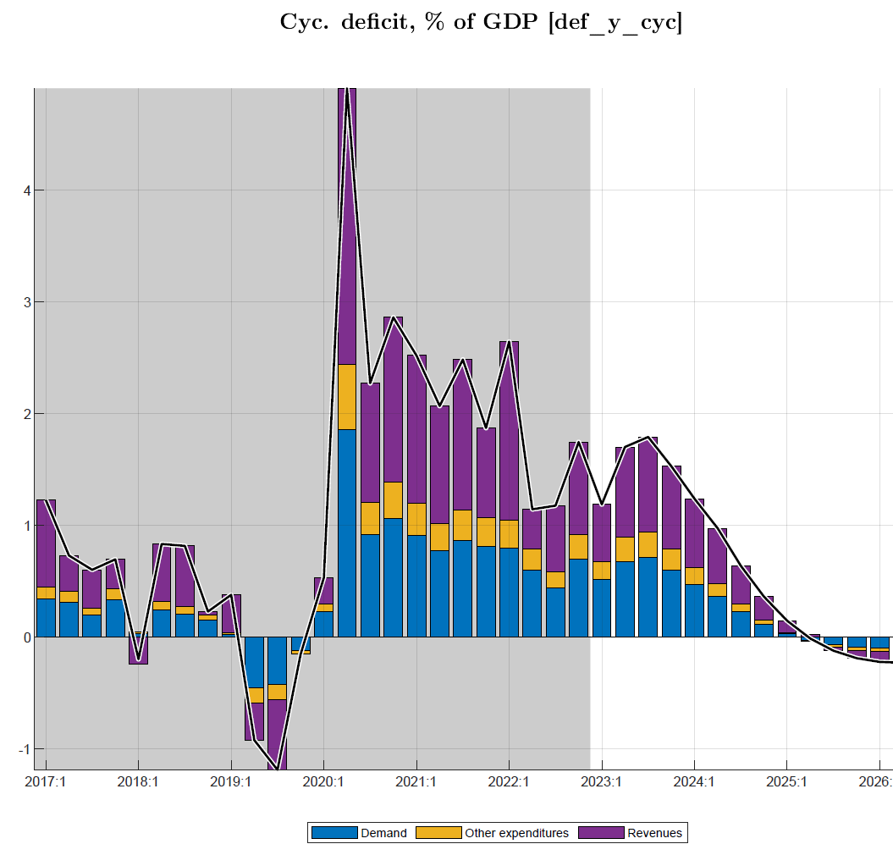
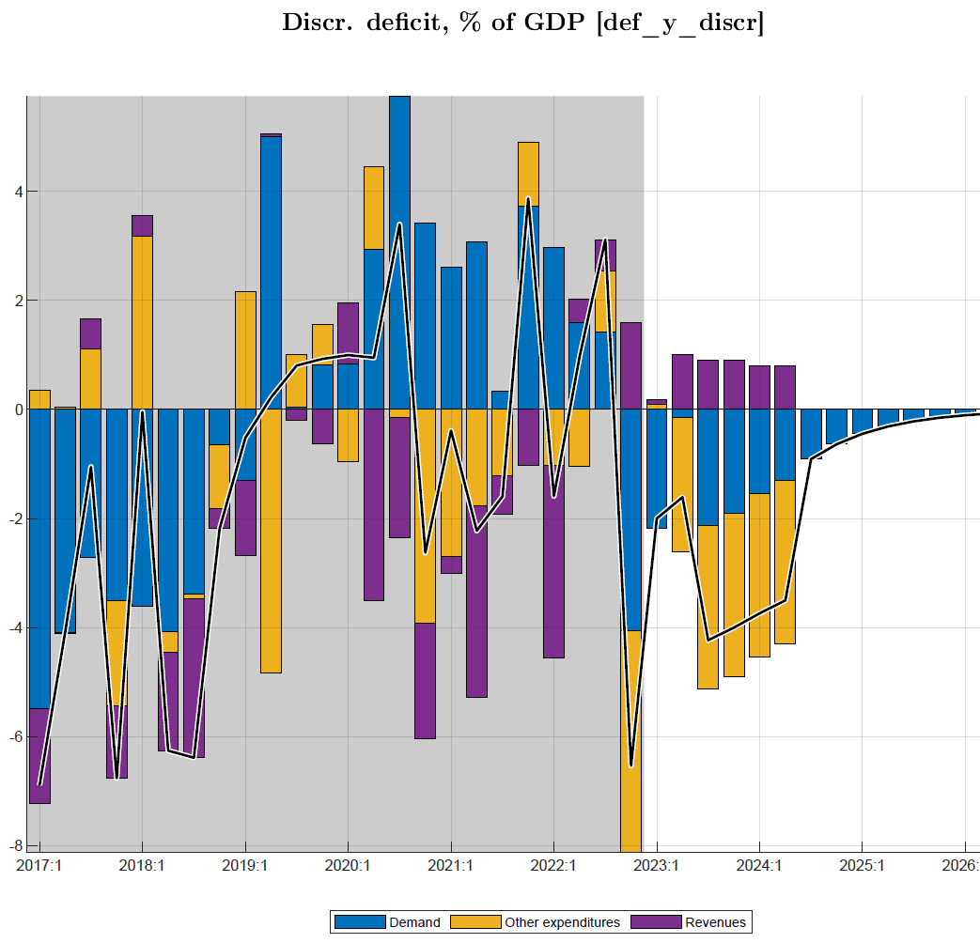
Fiscal stance: deficit and its components (discretionary, cyclical, structural)
Deficit discretionary & cyclical components forecast (w. near-term program), phasing out gradually
reductions in discretionary (demand G&S, other..) spending
losses in (non-tax), revenue, are gradually being offset
Cyclical deficit components phase out as output gap goes to zero
Notes:
Optional illustration of fiscal impulse in relation to output/gap

Slide 22
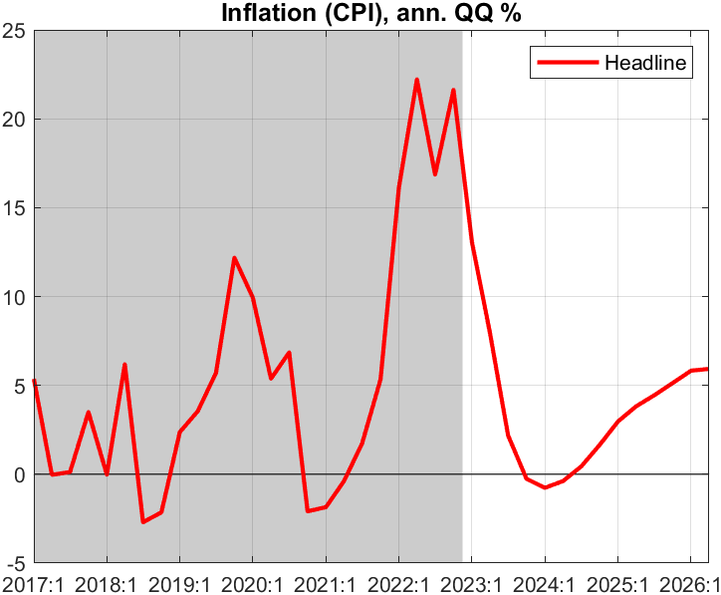
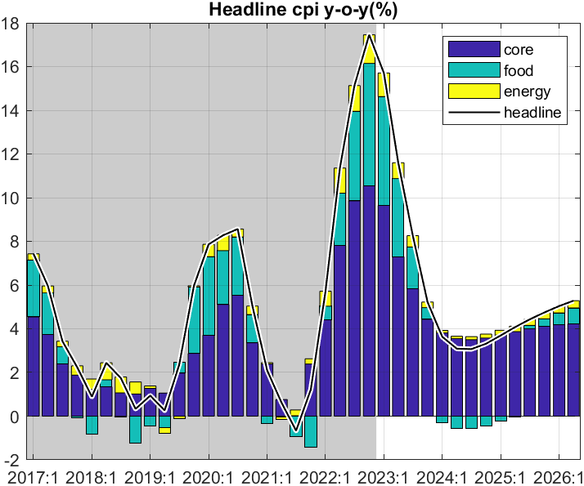
Forecast—Inflation outlook (overview)
decline in q-on-q inflation translates into less fast drop in y-on-y inflation, estimated to peak in Q4 2022 and dropping to below 5% in Q1 2024
all components drop, while drop in food prices contributes most
Headline CPI components
q-on-q annualized inflation is forecast to decline gradually in 2023 after peak in Q2 2022
predicated on recent shocks abating and inflation expectations being countered by NBR action and fiscal restraint
Notes:
Rationale of relative (food, energy) and therefore relative core price
Main message inflation: easing from interest rate and fiscal tightening (and abating shocks); reverse tightening of govt increases demand, output and a temporary above target inflation

Slide 23
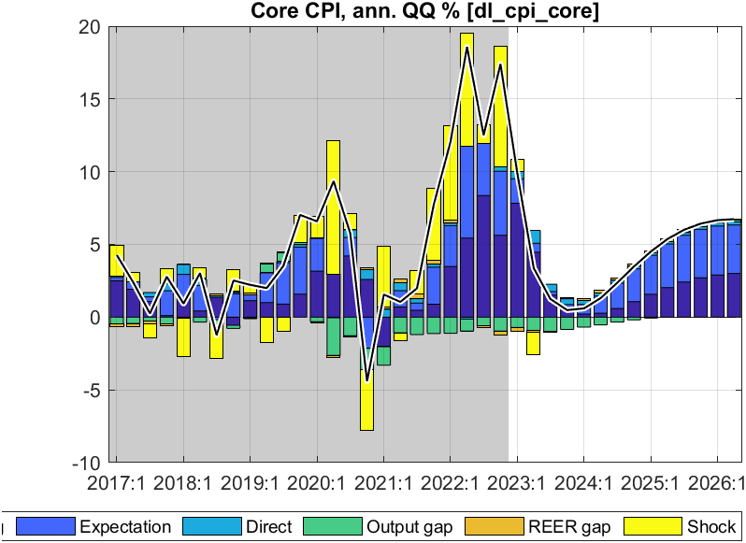
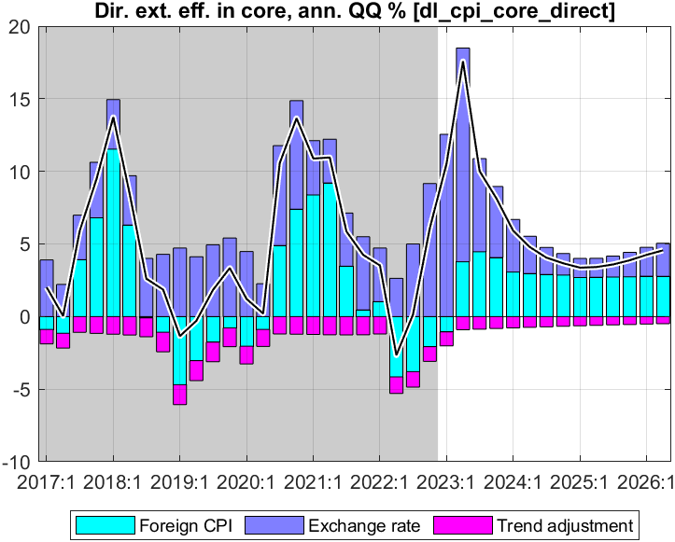
Forecast—Core inflation (q-on-q annualized)
Direct effect foreign import prices and ER on CPI core:
foreign prices continue declining for most of 2023-26
ER depreciation raises RWF prices, but net direct effect is small
CPI core down from peak 2022 Q4; main drivers:
down-pull effect from remaining output gap disappearing
strong effect of expectations and persistence
no direct effect of import prices as ~ constant in RWF terms

Slide 24
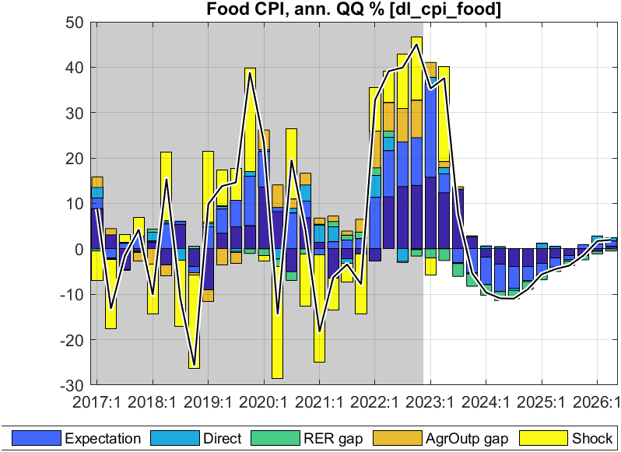
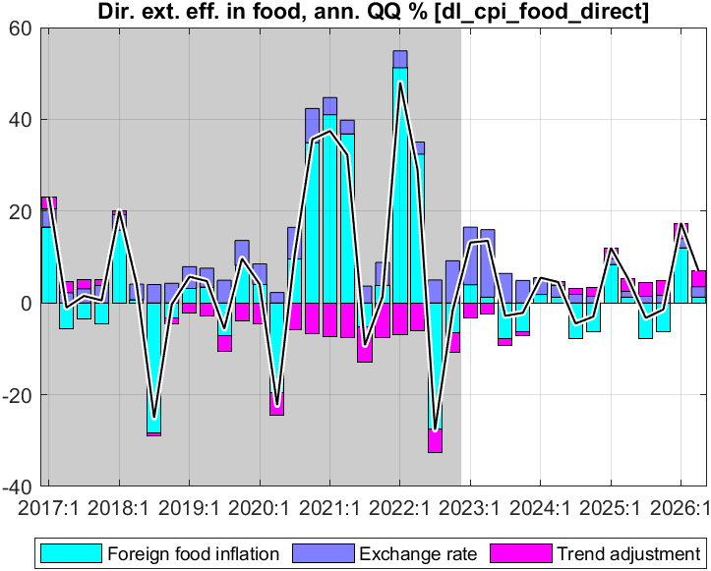
Forecast—Food inflation (q-on-q annualized)
Direct effect of foreign prices and ER on food CPI
foreign food prices continue declining for most of 2023-26
ER depreciation raises RWF prices but net direct effect is small
CPI food down from peak in 2022 Q4; main drivers:
agricultural output is forecast to normalize
imported food prices projected to continue declining
small offsetting effect of lessening RER overvaluation (faster depr.)
Notes:
Direct effect small as import share small for country (larger for urban)

Slide 25
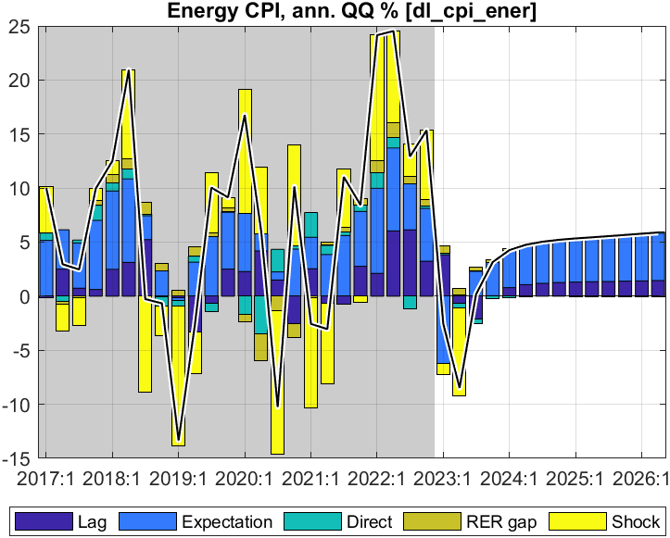
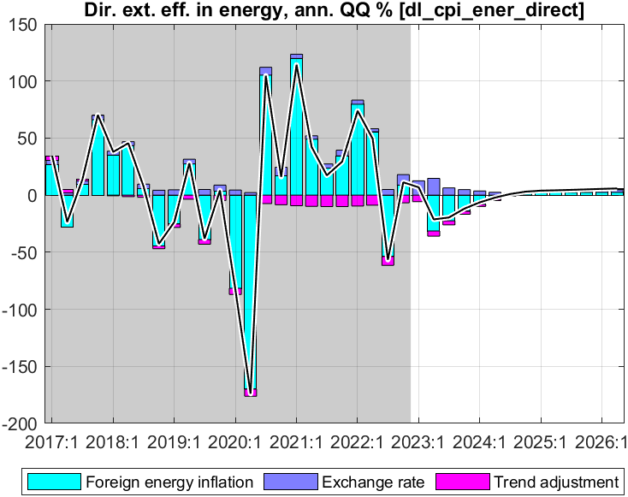
Forecast—Energy inflation (q-on-q annualized)
Direct effect foreign import prices and ER on energy CPI:
foreign energy prices continue declining for most of 2023-26
ER depreciation raises RWF prices, but net direct effect is small
CPI energy down from peak in 2022 Q2; main drivers:
imported energy prices projected to continue declining
small offsetting effect of lessening RER overvaluation (faster depr.)

Slide 26
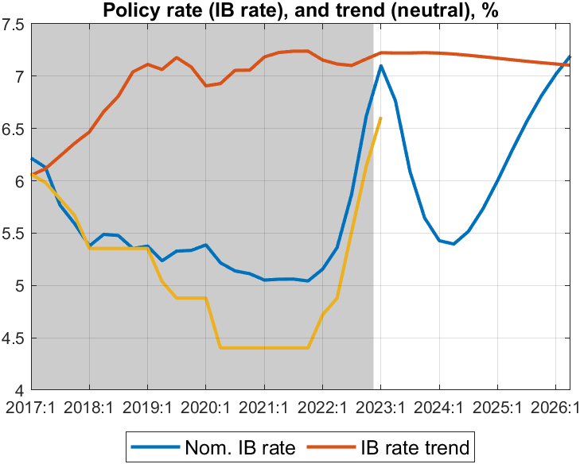
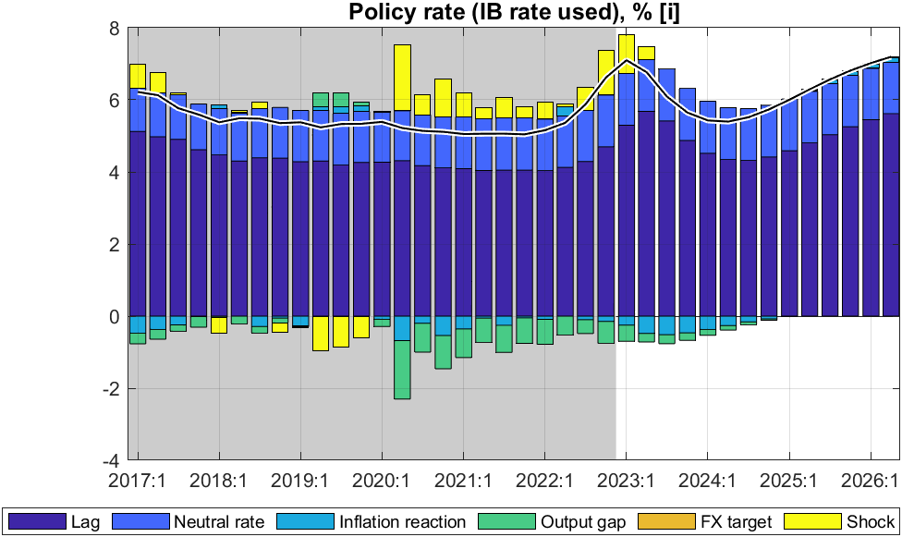
Forecast—Policy interest rate (interbank rate, IB)
Policy rate (IB) driven by rule:
responding to both inflation deviation (from 5% target) and the output gap
gradual interest rate changes (lagged effect)
pulled to ‘neutral’ rate of 7% (foreign real rate, country risk, core inflation)
Policy rate (IB) influenced by NBR with its CBR:
IB followed closely the 2% points CBR increases in 2022,, enacted to combat inflation
IB forecast to go down after peak in Q1 2023 given falling inflation and still high and rising output gap
from 2024, back to trend driven by a ‘neutral’ rate of almost 7%
increased policy rate should raise RIR and stem demand
Notes:
Why is IB not 7.4 in Q1 2023? We must convert back i= log(1+IB). Maybe need some IB smoothing, with lower drop in face of negative outputgap from govt demand?

Slide 27
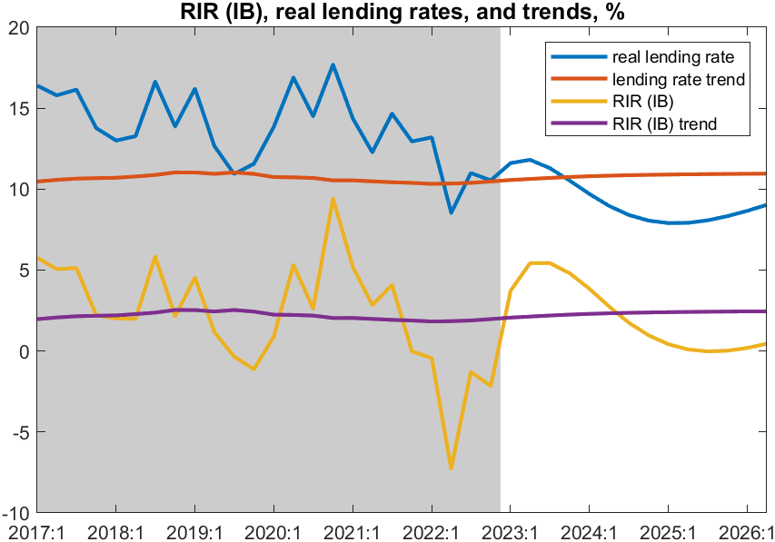
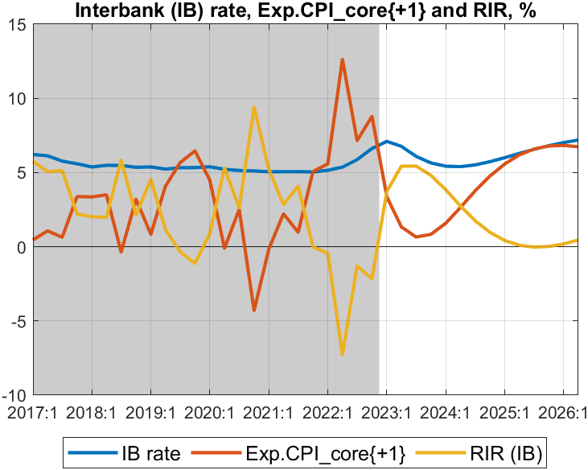
Forecast—Real interest rate (RIR) (policy and lending rates)
RIR policy rate (IB) components:
after sharp drop due to inflation surge in 2022, RIR starts rising from mid-2022 as policy rate increases and (expected) inflation declines
overshoots RIR trend (2%) a bit in 2023 as inflation drops fast, then undershoots RIR trend a bit as inflation temporarily above target
RIR policy rate (IB) (~ core-inflation one Q ahead)
forecast to continue rising and become positive from mid-2023
thus, correcting sharply below-trend levels since late 2021
after 2024, drops to zero as inflation a bit above target (as deficit and govt demand go back up to steady state levels)
then returning toward trend and ‘neutral’ rate of some 2%
real lending rate (including ~ 8% premium) also back to trend. ending the pull-up effect on private demand
Notes:
What explains RIR overshooting (above trend) in 2023? And below trend after2025-26?

Slide 28
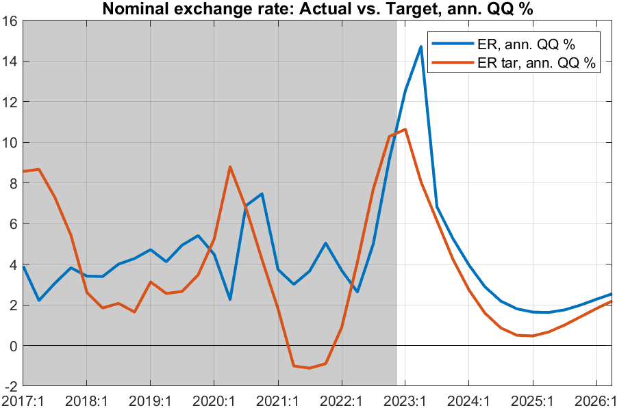
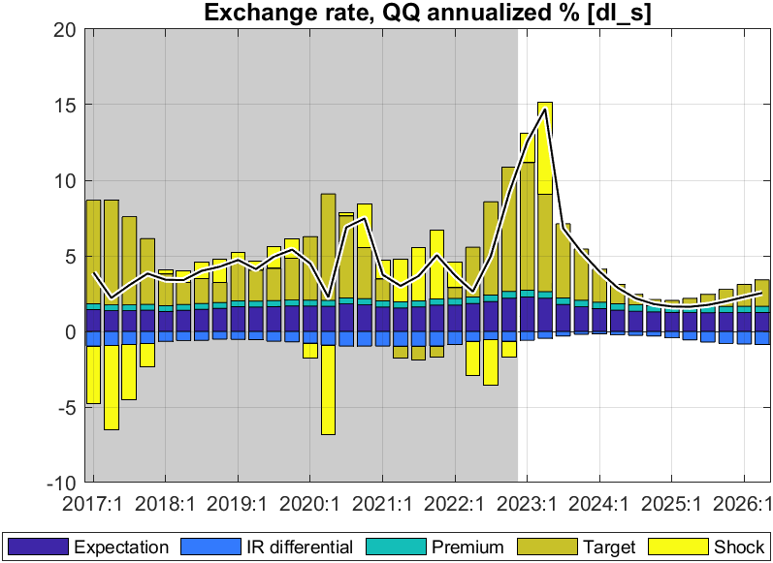
Forecast—Nominal exchange rate (ER)
Exchange rate policy “rule”
mainly driven by nominal ER target, expectations, and somewhat by domestic-foreign interest rate differentials.
ER target driven by trend RER depr. rate (0%) and inflation differential (2%)
ER policy reflected in forecast:
reflects NBR’s flexible ER policy, and hybrid rule:
ER steered toward target ER so that RER gradually falls in line with its target or trend depreciation rate
some response to domestic-foreign interest differentials
in 2023, before ER steered back to target
trend depreciation rate converges to 3% p.y.

Slide 29
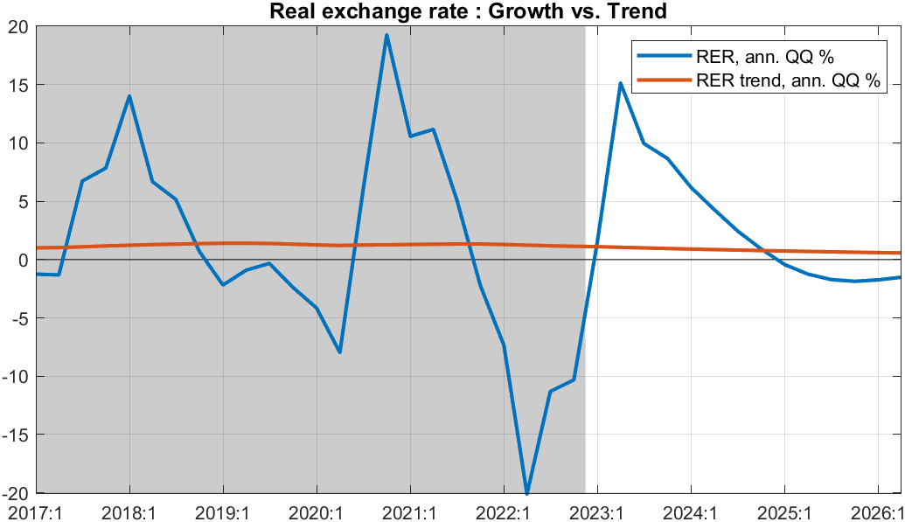
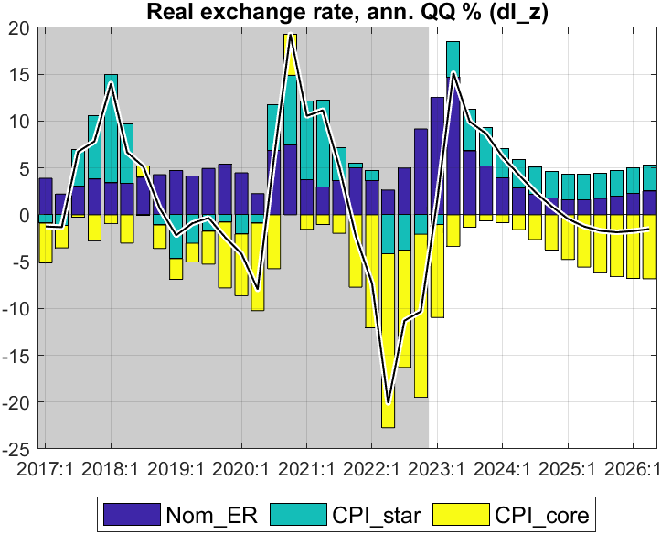
Forecast—Real exchange rate (RER, q-on-q change annualized)
RER components
after sharp decline in RER since Q3 2021 as core inflation surged,
RER is forecast to increase from Q2 2023 on for several quarters
before returning to its trend (0%), with some temporary undershooting
RER results from ER, CPI_core and foreign CPI
forecast to switch from real appreciation in 2022 and early 2023 to real depreciation from mid-2023
returning toward trend RER depreciation rate (0%) thereafter
pull-down effect on demand (from RER appreciation in most of 2022) becomes pull-up from 2023 on as RER returns to trend
Notes:
Seeming overshooting of RER (then some undershooting) desirable? Can it smoothened

Slide 30
Summary of policy stance and forecast outlook
Policy stance underlying the forecast
maintenance of recently increased policy interest rate (tuned for 2023Q2)
somewhat faster rate of exchange rate depreciation in 2023 (tuned for 2023Q1)
reduction fiscal deficit (before grants) to 12% of GDP in 2023Q1-2, then to 9.6% in 2023/24 (both tuned), then return to sustainable level of around 11% of GDP (unlike PCI, much lower deficit path through 2030)
positive fiscal stance—2% of GDP on average in 2019/20-2021/22—replaced by negative stance from 2022/23, then positive again in 2024/25 as deficit returns to sustainable level
Forecast of key macro indicators
RIR forecast to rise (albeit from a low negative level) and exert less upward pressure on private demand
RER forecasted to have faster depreciation and affect positively domestic demand (and trade balance G&S)
Headline inflation (peaked in Q4 2022) forecast to decline gradually in 2023 as food and energy prices are forecast to continue falling from their peaks in 2d half of 2022; and to be close to 5% target from 2024
GDP growth forecast to pick up to average 8.5% in 2023-24 before returning to its trend of 7.5% annually
Output back to potential as low (albeit rising) RIR and rising (of albeit still low) RER, keep demand up; this is countered in 2022/23-2023/24 by temporarily lower deficit, and output is back to potential only in 2026
Issue: address volatility (govt demand, output, inflation…) by smoothen govt deficit closer to sustainable level ?
Notes:
Both RIR and RER return gradually to their steady states of RIR of 2.5% and RER depreciation rate of 0%. (or is it 2% ie rstar 0%+country premium 2% CHECK). Should rstar_ss be raised to 0.5%?)

Slide 31
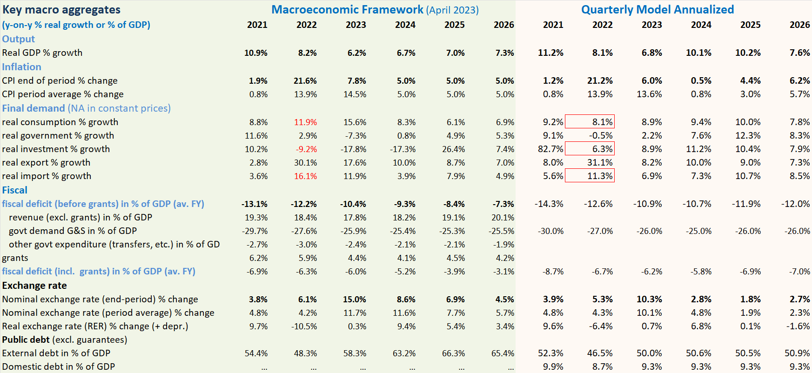
Comparison with Macro Framework

Slide 32
Comparison with Macroeconomic Framework (MF)
Illustrative comparison with April 2023 projection (PCI-RSF)
compared to MF, the annualized QMFM result has:
lower volatility in final demand components, especially for consumption, investment and imports (MF needs consumption-savings checks)
lower average CPI inflation in 2023-24, as QMFM captures the impact of the large negative fiscal stance
lower ER depreciation from 2024, as it forecast zero RER depreciation in medium term
(MF has real depreciations each year in 2024-26, over 20% cumulatively; cp. to QMFM 6%)
higher fiscal deficits from CY 2024—returning to sustainable level--while MF-PCI has deficit much below that for 5 years

Slide 33
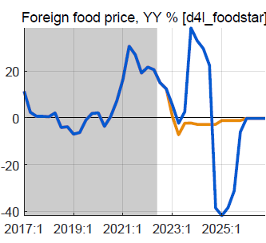
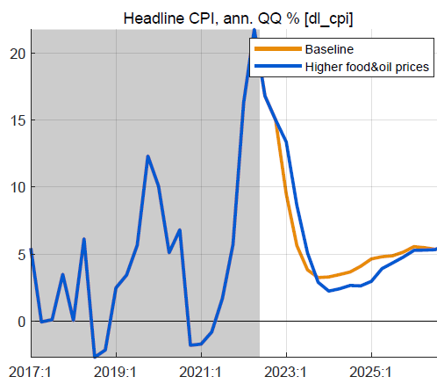
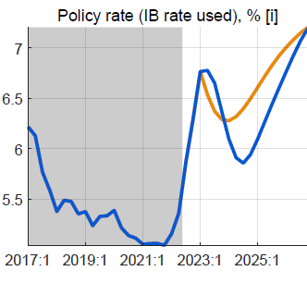
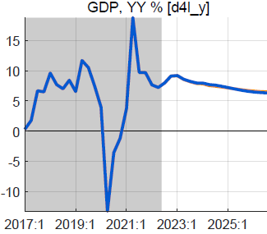
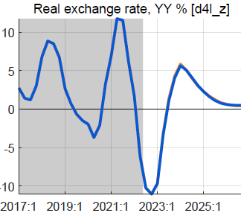
Alternative scenario: higher foreign food/oil prices (2023-24)
Higher-than-WEO foreign food and oil prices in 2023-24
foreign food and oil prices on average 25% higher than BL
with peak around end-2023, return to WEO levels from 2025
no change in fiscal policy
Results in higher headline CPI, little or no effect on output
headline CPI temporarily higher, reflecting food/oil import shares
small response policy rate, reversed fast as expected inflation drops
small positive effect on demand of lower RIR
mostly offset by negative effect of slightly more appreciated RER
overall effect on GDP is very small, less than 0.2%

Slide 34
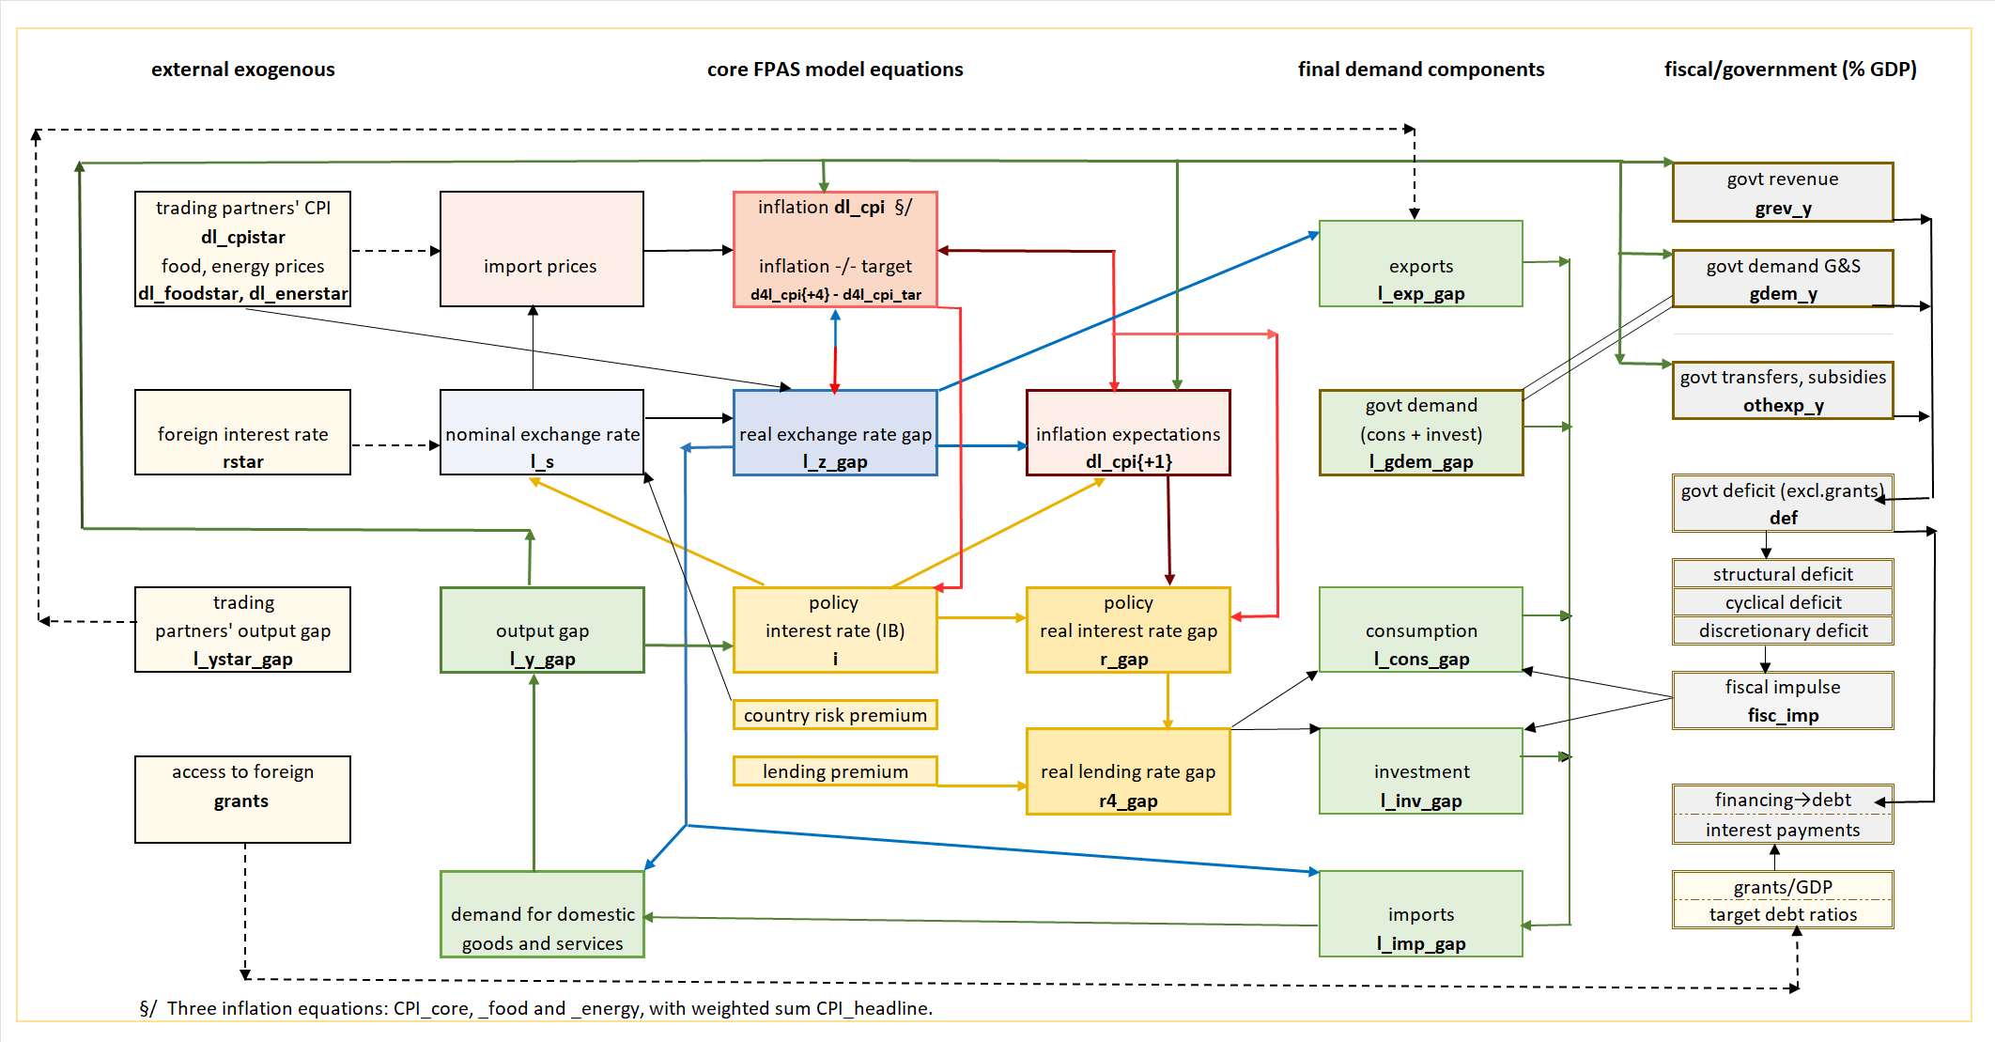
QMFM: main relationships and transmission mechanisms

Slide 35
THANK YOU

